Slide 1
unit :5 wind Energy and biomass
Wind Energy and Biomass
Types of wind mills, Wind power availability, and wind power development in India. Evaluation of sites for bio-conversion and bio-mass, Bio-mass gasification with special reference to agricultural waste.

Slide 2
Introduction
A windmill is a structure that converts wind power into rotational energy by means of vanes called sails or blades, specifically to mill grain, but the term is also extended to windpumps, wind turbines and other applications.
Windmills were used throughout the high medieval and early modern periods; the horizontal windmill first appeared in Greater Iran during the 9th century, the vertical windmill in north western Europe in the 12th century
Windmills are those machines that help us harvest the wind energy to produce electricity. Windmills convert the kinetic energy of wind to electricity.

Slide 3
Types of wind mills
There are two types of designs in windmill:
Vertical axis windmills
Horizontal axis windmills

Slide 4
Vertical Axis Windmills
In the early development stage, vertical axis wind mills were very popular and were in wide use. It is in such a design that the blades will be perpendicular to the ground. These vertical axis wind mills were replaced by the horizontal axis windmills later due to its incompetence. This was mainly used for grinding grains or pumping water.
The vertical axis windmill is called as horizontal windmills. Thus please do not confuse yourself with both the names as if you miss the word “axis”, the whole idea and meaning will change, giving you the antonym.

Slide 5
Horizontal Axis Windmills
Horizontal axis windmills won the hearts of many due to its efficiency and productivity. It is known for its elasticity design as it harness more wind and easy for the operating person to change the direction according to the wind flow.
This horizontal axis windmills are called as vertical windmills. There are different kinds of horizontal axis windmills, namely,
Post Mill
Smock Mill
Tower Mill
Fan mill

Slide 6
Post Mill
It was the most old horizontal axis windmill. The unique feature is that it is mounted on a single vertical post, on which it can be turned. It was named post mill as the most significant part is the post on which the mill is turned. In earlier times the post was concealed on an base which was replaced by a wooden support called trestle. Trestle, being wooden requires protection and thus surrounded by a round house.
Post mills have different categories:
Sunk Post Mill
Open Trestle Post Mill
Post Mill with roundhouse
Hollow Post Mill
Composite Mill
Paltrok mill
The 19th century saw the decline in Post mills when they were replaced by other powerful windmills such as tower and smock mills.

Slide 7
Smock Mill
Smock mills are those horizontal boarded towers which generally have six to eight sides. The name got originated from the shape of its body as it looks like a smock. This part of the mill is thatched and will be round shaped. The main feature of the smock mill is that, the top part of it is flexible. Thus, this part can be moved around according to the direction of wind, while the other part remains stable. The main body part being stable, it can be much bigger and taller. As we know, the taller the tower, the more wind it could harvest. The productivity will be always high.

Slide 8
Tower Mills
Tower mill is very similar to that of the smock mill. The only difference is that the body of the tower mill is made of bricks or stones, making it very strong and resistant. Like wise in smock mill, only the cap will be flexible. The durability of tower mills always ranks high along with the efficiency. The body can be built in any height since it is made with the stones or bricks.

Slide 9
Fan Mills
Fan mills are small windmill designs for single use purpose. It has four to twenty bades and mainly used for pumping water.

Slide 10
Wind power availability in India
Wind power generation capacity in India has significantly increased in recent years. As of 29 February 2020 the total installed wind power capacity was 37.669 GW, the fourth largest installed wind power capacity in the world.
Wind power capacity is mainly spread across the Southern, Western and Northern regions.
Wind power costs in India are decreasing rapidly
The levelised tariff of wind power reached a record low of ₹2.43 per kWh (without any direct or indirect subsidies) during auctions for wind projects in December 2017.]In December 2017, union government announced the applicable guidelines for tariff-based wind power auctions to bring more clarity and minimise the risk to the developers.

Slide 11
Wind power development in India.
India currently has an installed wind power generation capacity of 22,465 MW. Also, barely 12% of the total power generation is from renewable sources.
The remaining 88% of power depends on other energy resources. Offshore wind power policies should be developed; it helps to increase the wind power energy.

Slide 12
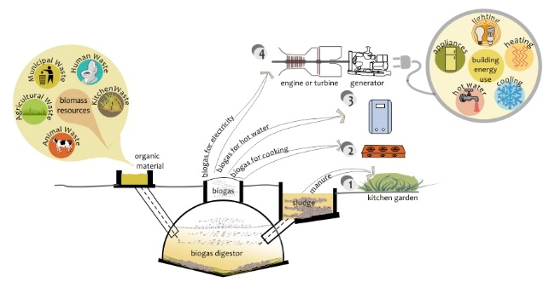
Bio Mass

Slide 13
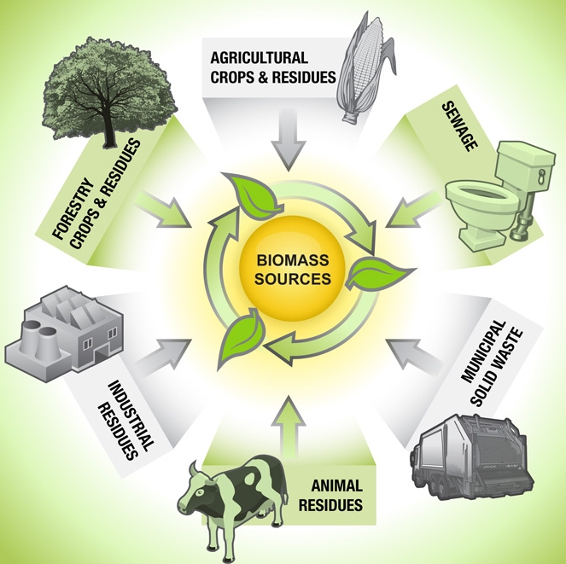
Bio Mass

Slide 14
Bio-mass
Biomass is plant or animal material used for energy production (electricity or heat), or in various industrial processes as raw substance f.or a range of products.
Biomass is fuel that is developed from organic materials, a renewable and sustainable source of energy used to create electricity or other forms of power.

Slide 15
Bio-Fuels
Biofuel, any fuel that is derived from biomass—that is, plant or algae material or animal waste. Since such feedstock material can be replenished readily, biofuel is considered to be a source of renewable energy, unlike fossil fuels such as petroleum, coal, and natural gas.
Solid:- Wood , strew , municipal refuse
Liquids :- Methanol, Vegetable oil,
Gases :- Fuel Gas,

Slide 16
Bio-conversion
Biomass conversion to fuels, heat and power ,Animal manure, as most wet biomass types can be converted to biogas through anaerobic digestion, a biochemical process that is used to break the biogenic carbon and transform it to a mixture of methane and carbon dioxide through a complex series of chemical reactions.
Thermal Conservation
Bio chemical conservation

Slide 17
Thermal conversions
Thermal conversion processes use heat as the dominant mechanism to upgrade biomass into a better and more practical fuel. The basic alternatives are torrefaction, pyrolysis, and gasification, these are separated principally by the extent to which the chemical reactions involved are allowed to proceed
There are other less common, more experimental or proprietary thermal processes that may offer benefits, such as hydrothermal upgrading.^{[13]} Some have been developed for use on high moisture content biomass, including aqueous slurries, and allow them to be converted into more convenient forms.

Slide 18
Biochemical conversion
As biomass is a natural material, many highly efficient biochemical processes have developed in nature to break down the molecules of which biomass is composed, and many of these biochemical conversion processes can be harnessed. In most cases, microorganisms are used to perform the conversion process: anaerobic digestion, fermentation, and composting.
Glycoside hydrolases are the enzymes involved in the degradation of the major fraction of biomass, such as polysaccharides present in starch and lignocellulose. Thermostable variants are gaining increasing roles as catalysts in biorefining applications, since recalcitrant biomass often needs thermal treatment for more efficient degradation.

Slide 19
Wet process
Anaerobic digestion :- Anaerobic digestion is a process through which bacteria break down organic matter—such as manure—without oxygen. As the bacteria “work,” they generate biogas. Co digestion occurs when anaerobic digestion is used to break down multiple types of organic waste in one anaerobic digester
Fermentation:- Fermentation is an anaerobic process in which energy can be released from glucose even though oxygen is not available. Fermentation occurs in yeast cells, and a form of fermentation takes place in bacteria and in the muscle cells of animals.
Chemical Reduction :-

Slide 20
Dry Process
Pyrolysis :-Pyrolysis is a process of chemically decomposing organic materials at elevated temperatures in the absence of oxygen. The process typically occurs at temperatures above 430 °C (800 °F) and under pressure. It simultaneously involves the chaLiquefactionnge of physical phase and chemical composition and is an irreversible process.
:- liquefaction is a process that generates a liquid from a solid or a gas or that generates a non-liquid phase which behaves in accordance with fluid dynamics.
Gasification:- Biomass gasification is a process of converting solid biomass fuel into a gaseous combustible gas (called producer gas) through a sequence of thermo-chemical reactions. The gas is a low-heating value fuel, with a calorific value between 1000- 1200 kcal/Nm3 (kilo calorie per normal cubic metre).
Steam Gasification:-Steam gasification. To start with, gasification is a chemical process that converts carbonaceous materials like biomass into useful gaseous fuels or chemical feedstock. Gasification takes place in an oxygen-deficient environment requiring heat.

Slide 21
