Slide 1




INTRODUCTION TO
COMPUTER AIDED DESIGN
By
Asst Prof Kadam Arjun

Slide 2

Contents
CAD/CAM definition
The Product Cycle and CAD/CAM
Introduction to Computer Technology
Computer Programming Languages
Fundamentals of CAD
The Design Process
The Application of Computers for design
Benefits of CAD
CAD Hardware
CAD Software

Slide 3



CAD/CAM Defined
CAD/CAM means computer-aided design and computer-aided manufacturing. It is the technology concerned with the use of digital computers to perform certain functions in design and manufacturing.
CAD can be defined as the use of computer systems to create, modify, analyze, or
optimize an engineering design.
Computer System
CAD
Hardware
CAD
Software
Fig. 1: Computer system configuration for CAD

Slide 4
CAD/CAM Defined
CAM can be defined as the use of computer systems to plan, manage, and control the operations of a manufacturing plant through either direct or indirect computer interface with the plant’s production resources.
The applications of CAM fall into two broad categories:
  Computer monitoring and control
  Manufacturing support applications
CAM
Computer monitoring and control
Manufacturing support applications
Fig. 2: Applications of CAM

Slide 5
CAD/CAM Defined
Computer monitoring and control: These are direct applications in which the computer is connected directly to the manufacturing process for the purpose of monitoring or controlling the process. Computer monitoring and control can be separated into monitoring applications and control applications.
  Computer process monitoring: It involves a direct computer interface with the manufacturing process to observe the process and associated equipment and collects data from the process.
  Computer process control: It goes one step further than monitoring by not only observing the process but also controlling it based on the observations.
Computer
Process
Process data
(a)
Process data
Computer
Control Signals
Process
(b)
Fig. 3: Computer monitoring and control: (a) Computer monitoring ; (b) Computer control

Slide 6
CAD/CAM Defined
2. Manufacturing support applications: These are indirect applications in which the computer is used in support of the production operations in the plant, but there is no direct interface between the computer and the manufacturing process. Here computer serves a support role in the manufacturing operations and is used “off- line” to provide plans, schedules, forecasts, instructions and information by which the firm’s production resources can be managed more effectively.
Process data
Computer
Manufacturing operations
Control Signals
Fig. 4: Manufacturing support applications

Slide 7

The Product Cycle & CAD/CAM
Various activities + functions = Product Cycle
Product
concept
Design engineering
Drafting
Customers
and markets
Order new equipment and tooling
Process
planning
Quality control
Production
Production scheduling
Fig. 5: Product Cycle

Slide 8
The Product Cycle & CAD/CAM
Computer-aided design
Computer-automated drafting and documentation
Product concept
Design
engineering
Drafting
Customers and
markets
Order new equipment and tooling
Process planning
Computer-aided process planning
Quality control
Production
Scheduling
Computer-aided
quality control
Computer controlled
robots, machines, etc.
Computerized scheduling,
MRP, shop floor control
Fig. 6: Product Cycle revised with CAD/CAM overlaid

Slide 9

Computer Technology
The central and essential ingredient of CAD/CAM is the digital computer.
The modern digital computer is an electronic machine that can perform mathematical and logical calculations and data processing functions in accordance with a predetermined program of instructions.
There are three basic hardware components of a general-purpose digital computer:-
  Central processing unit (CPU)
  Memory
  Input/output (I/O) Section
➢
Peripheral devices (reader, printer, etc.)
or
mass memory
CPU
Input/output
Control unit
Arithmetic logic unit
Memory
Computer Outside world
Fig. 7: Basic hardware structure of a digital computer

Slide 10

Fundamentals of CAD
Modern CAD systems are based on Interactive Computer Graphics (ICG).
ICG is a system in which computer is used to create, transform, and display data in the form of pictures or symbols.
The ICG system and the human designer are the major components of a CAD system. Interactive computer graphics is a tool used by the designer to solve a design problem. In effect, the ICG system magnifies the powers of the designer. This has been referred to as the synergistic effect.
The designer performs the portion of the design process that is most suitable to human intellectual skills (conceptualization, independent thinking) whereas the computer performs the task best suited to its capabilities (speed of calculations, visual display, storage of data), and the resulting system exceeds the sum of its components.
Fundamental reasons for implementing a CAD system
To increase the productivity of the designer.
To improve the quality of the design.
To improve communication.
To create a database for manufacturing.

Slide 11





The Design Process
It is an iterative procedure, given by Shigley, for designing something. It consists of six identifiable phases.
Recognition of need
Definition of
problem
Synthesis
Analysis and optimization
Evaluation Presentation
Fig. 7: The general design process

Slide 12
WHAT IS DEVICE
It can be defined as the components or peripherals which are attached to the computer to enter the data and get the desired result

Slide 13
Input Devices
The devices which are used to give data and instructions to the computer are called Input Devices. Various types of input devices can be used with the computer depending upon the type of data you want to enter in the computer

Slide 14
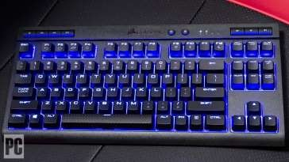
Keyboard
It is the most commonly used input device. It is used to enter data and instructions directly into the computer. There are 104 buttons on the keyboard which are called keys.

Slide 15
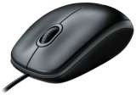
Mouse
Mouse is another input device which is commonly found connected with the computers. It is basically a pointing device which works on the principle of Point and Click. When the mouse is moved on the mouse pad, a light beam underneath reflect to give motion to the pointer on the screen.

Slide 16
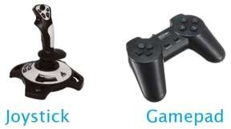
Joystick and Game-pad
Joystick and game-pad are also input devices which are also input devices which are used to control the movement of object on the screen. Just like mouse, these are also pointing devices. Mostly they are used for playing games on the computer.
The joystick has a vertical stick with a track ball at its bottom. While playing the games on the computer, the user needs to move the objects quickly on the screen. With the movement of this vertical stick the objects can be moved in all the directions easily.
A game-pad is a type of game controller held in two hands, where the fingers (especially thumbs)are used to provide input by pressing buttons on it. It is also known as Control Pad.

Slide 17
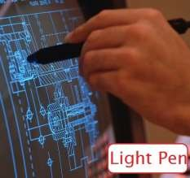
Light Pen
Light pen is another pointing type input device. It is a pen shaped device which can be used by directly pointing the objects on the screen. It can also be used for making drawings directly on the monitor screen.

Slide 18
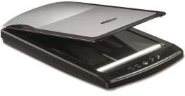
Scanner
We can store pictures, photographs, diagrams into the computer with the help of scanner. The scanner reads the image and saves it in the computer as a file.

Slide 19
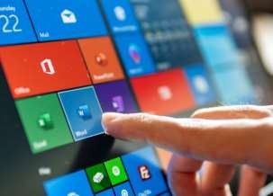
Touch screen
Touch screen is a special computer screen that takes the input by sensing the touch of a human finger, gloved hand, stylus, pen or any other pointing device. The user gives instructions to the computer just by touching the screen.

Slide 20
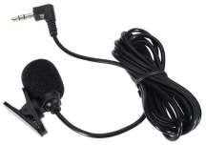
Microphone
This is an input device which is used to record sound or voice into the computer system. You can store voice data in the computer by speaking in front of this device.

Slide 21
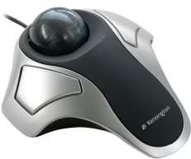
Trackball
A trackball is similar to a mouse but is mounted in a fixed position. The user spins the ball with fingers to move the pointer on the screen.
A Trackball technology was used in earlier laptop computer which is now replaced with track-pad.

Slide 22
Output Devices
The devices which are used to display the results or information are called Output Devices. You can view the output on the monitor or you can print it on a paper using a printer. Monitor and the printer are the commonly used output devices.

Slide 23
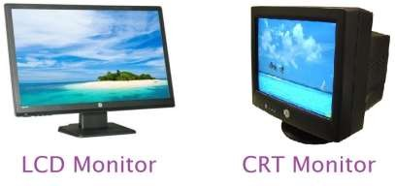
Monitor
This is the most common output device connected with the computer to display the processed information. It looks like a TV and is also know as VDU(Visual Display
Unit). Pictures are displayed by using a large number of very small dots on screen called pixels. The number of pixels that a monitor can show on its screen is referred to as the resolution of the screen

Slide 24
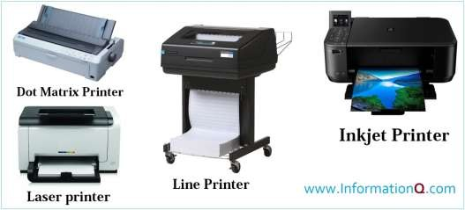
Printer
This is an important output device of the computer system. It gives a printed output of the results that appears on the monitor screen

Slide 25
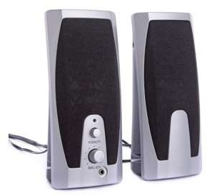
Speaker
Speakers are categorized as output devices. These are used to listen to the music and sounds played by the computer. Normally they come in a pair and have different shapes and sizes.

Slide 26
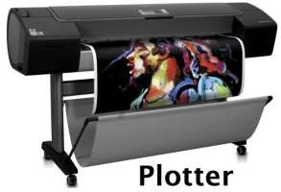
Plotter
We can get the print of a photograph, drawing, image stored in the computer, by using a plotter. It is an output device which provides a high quality of printed output. It is generally used by engineers and architects.

Slide 27
Let’s summarize
Input devices are used to give data and instructions to the computer.
Keyboard and mouse are the most commonly used input
devices.
Microphone gives sound or voice input to the computer.
Output devices are used to display the result or information on the computer.
Monitor and the printer are the commonly used output
devices.
The output seen on the VDU is called soft copy.
The printed copy of the output is called hard copy.
Speakers are used to listen to the music and sounds played by the computer.
Plotter are used for a high quality of printed output.

